Slide 1
CAD
Advance Meshing
Sketching & Styling
FEA
Surfacing & Rendering
ERFOLG Engineering Services LLP

Slide 2
Organisation
Company
Mission
ERFLOG will deliver the highest value for money to our Customer as we are committed to Quality Services within stipulated timeframe to delight our Customer.
Vision
ERFLOG Is to be the global leader in Customer Value

Slide 3
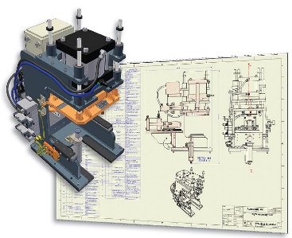
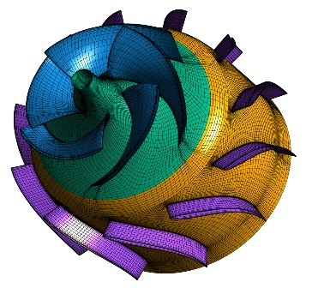
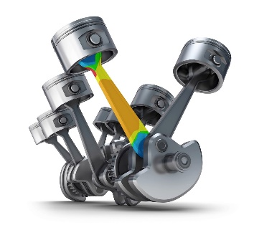
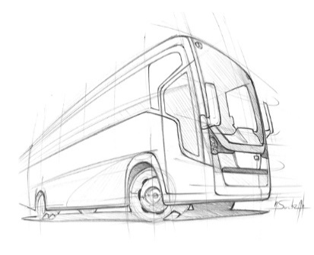
Engineering Services
Four core engineering area with several years of experiences
ERFOLG help to customers develop complex design and products, significantly reducing their time-to-market and helping them penetrate both emerging and existing markets. Our capabilities include CAD Modeling, Sketching, Styling & Rendering, Advance Meshing and FEA Analysis.
CAD
Sketching,
Styling &
Rendering
Advance
Meshing
FEA
(Computer Aided Design)
(Finite Element Analysis)

Slide 4
CAD
(Computer Aided Design)

Slide 5
CAD
ERFOLG have a team of engineer with expertise across a wide range of engineering disciplines & industries that we provide consulting support based on your specific needs & requirements to generate high quality CAD Model on different platform including high end popular CAD program suit like AutoCAD, Solidworks, Unigraphics NX, Pro-E & CATIA.
Our Capabilities
Legacy data conversion, 2D to 3D conversion services
Parametric part modelling and CAD customization
Design of interior and exterior parts
Full Vehicle integration and design of under-body parts
Adaptation of existing design to new vehicle variants
Preparation of intermediate BOM for procurement
CAD data conversation/migration
Reverse engineering
Design of large structures as per design standards and codes

Slide 6
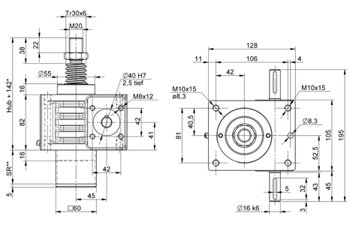
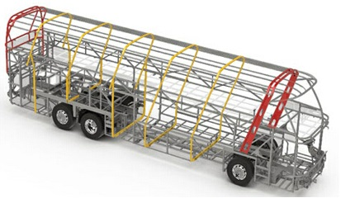
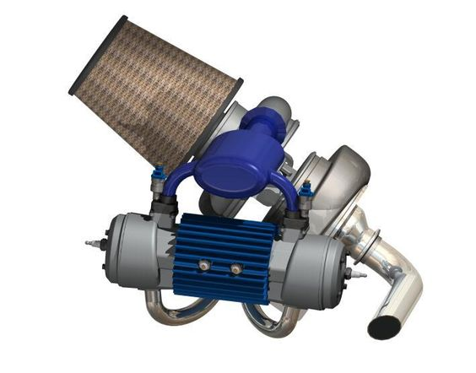
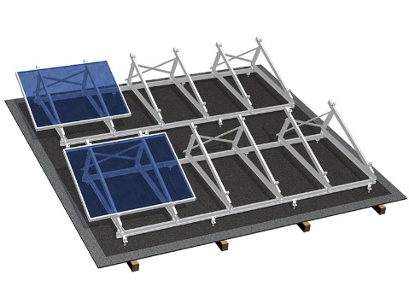
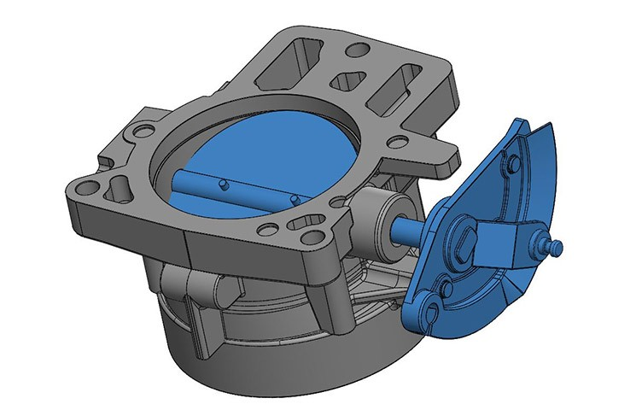
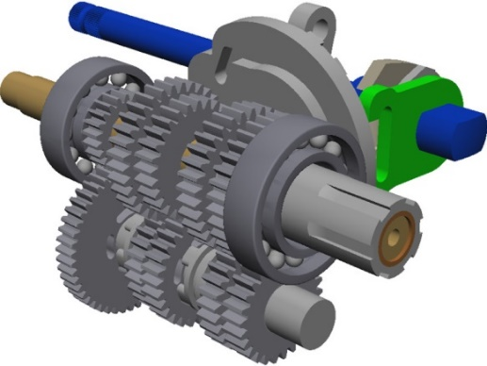
Project

Slide 7
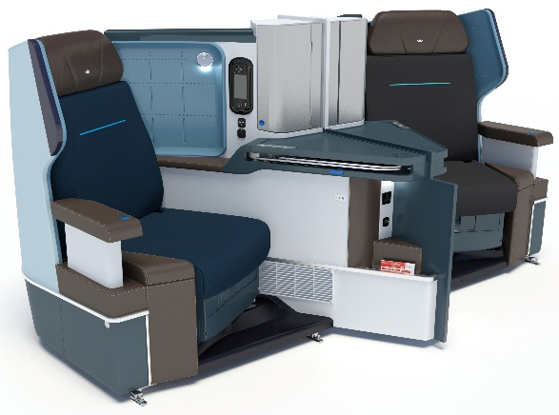
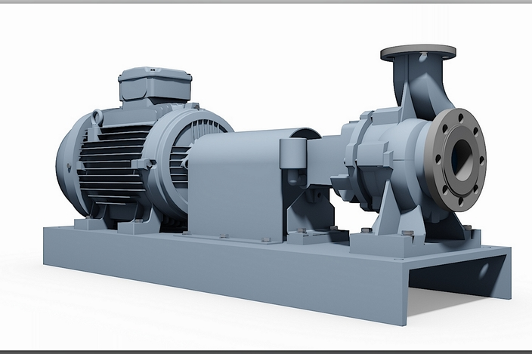
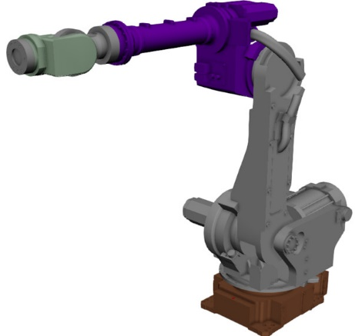
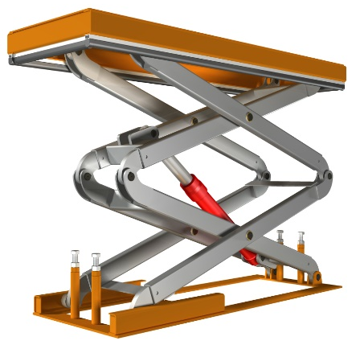
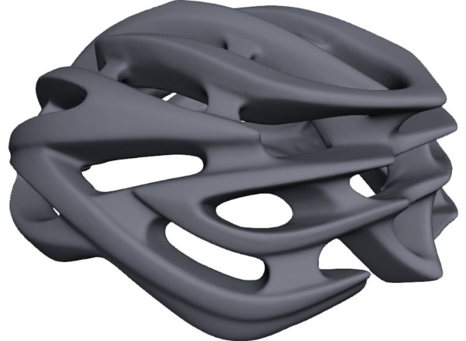
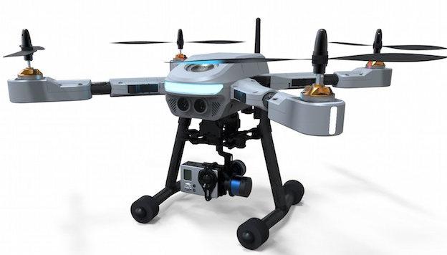
Project

Slide 8
Sketching, Styling & Rendering

Slide 9
Sketching, Styling & Rendering
ERFOLG support and advise the customer at every step During the entire development process. Regular and secure data synchronization for visualization and cubing purposes is also used as a monitoring instrument. The group-wide networking of expertise in our Design Centers enables us to create design concepts in the shortest possible time. ERFOLG's competence from " Sketch to Virtual Prototyping " describes tailor-made and innovative design services.
Our Capabilities
Hand Sketches
Surface Mondeling
Design of interior and exterior parts
Benchmarking & Product placement
Surface smoothing Class A and Class B
Lettering/logos
Technical visualization & presentation

Slide 10
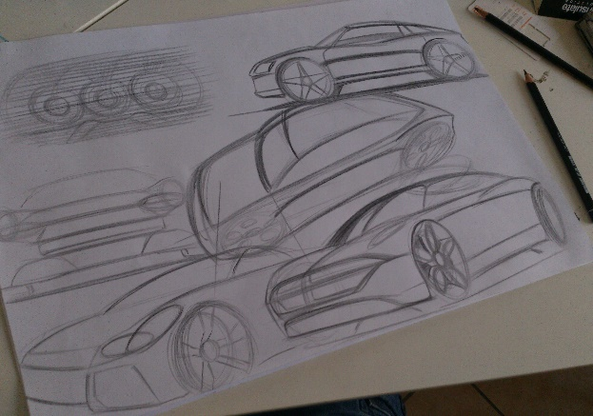
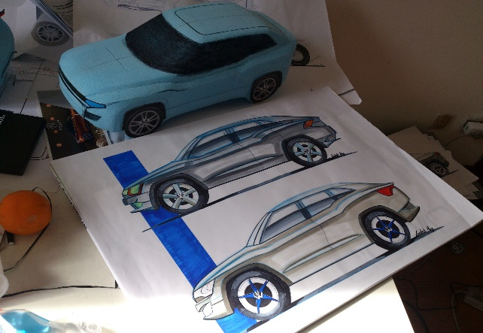
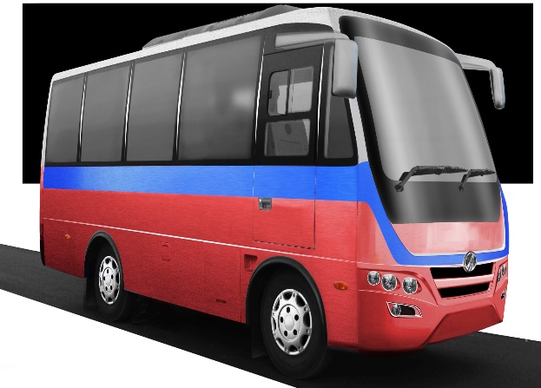
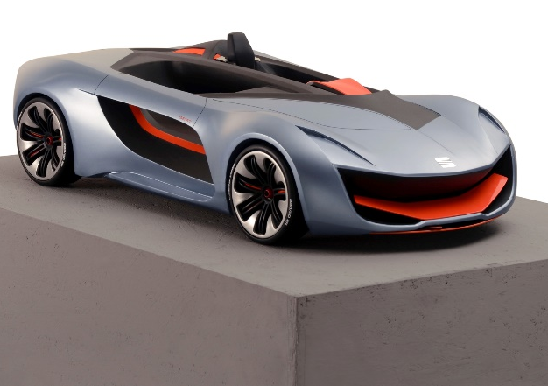
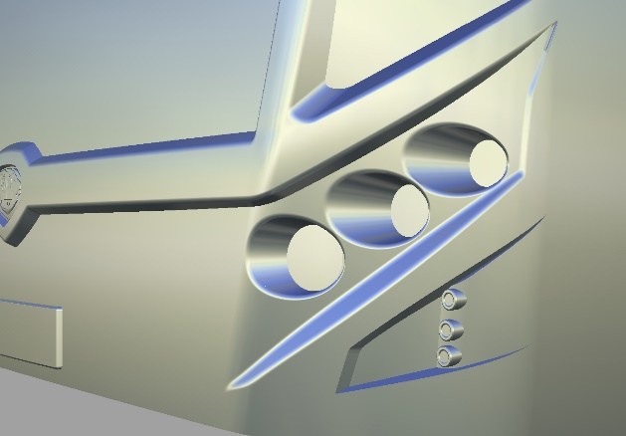
Project

Slide 11
Advance Meshing

Slide 12
Advance Meshing
ERFOLG have a team of engineer with expertise across a wide range of engineering disciplines & industries that we provide consulting support based on your specific needs & requirements to generate high quality Meshing with using ANSYS, Hypermesh & ANSA Platform
Proprietary shell meshing algorithms
High performance & Quality volume meshing algorithm
Hexahedral dominant meshing
Mesh creation on extracted middle surface
Shell meshing ( thin shell, symmetric and axisymmetric problems )
Solid meshing ( complicated solid parts and CFD problems)
Acoustic cavity mesh
Our Capabilities

Slide 13
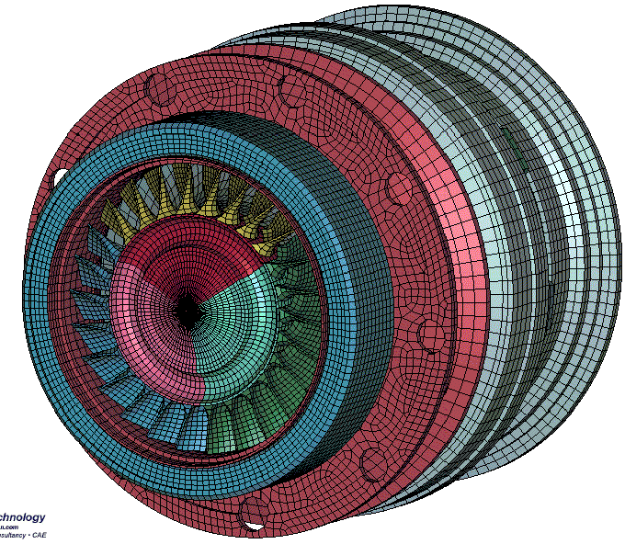
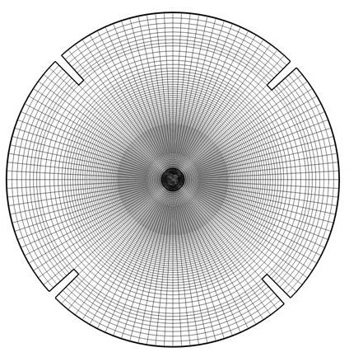
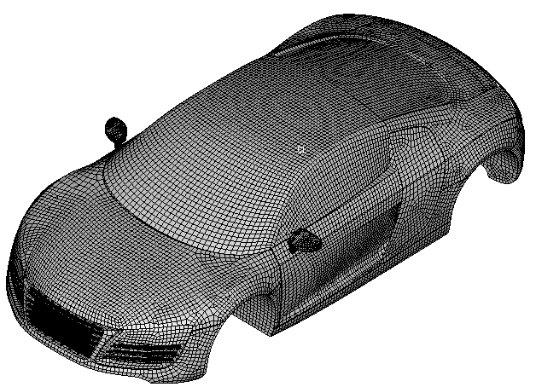
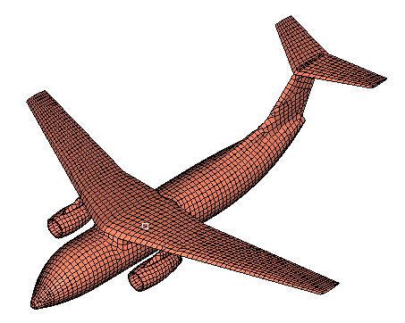
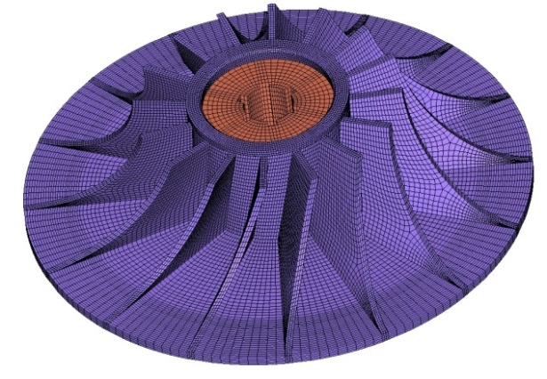
Project

Slide 14
FEA
(Finite Element Analysis)

Slide 15
FEA
Finite Element Analysis (FEA) is generally recognized as an important method of improving productivity. One of the major benefits of this technology has been to reduce the amount of manual work force spent analyzing changes made to vehicle designs. By using existing data, computer-aided design (CAD) can be used to co-ordinate the spatial relationships in the Automotive (on road & off road vehicle), Aerospace, Oil & Gas, Heavy Engineering and Solar.
Our Capabilities
Structural Analysis
Thermal & Electrical Simulation
Dynamic Simulation
Durability & Fatigue Simulation
Roll Over Simulation
Crash Analysis
Product optimization and weight reduction
Data Collection & Report Creation

Slide 16
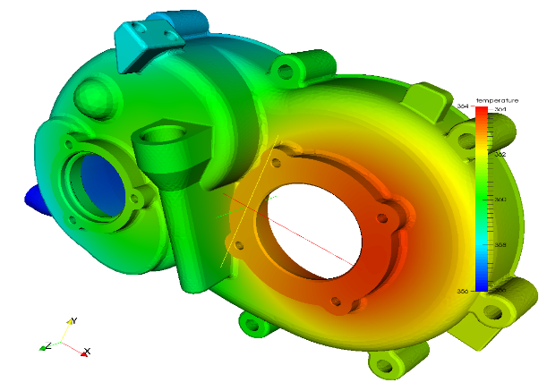
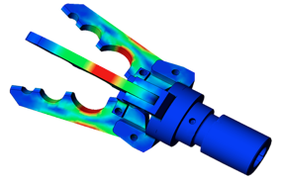
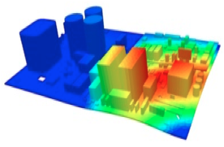
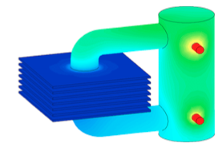
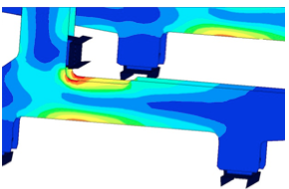
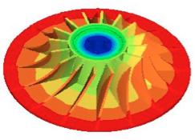
Project

Slide 17
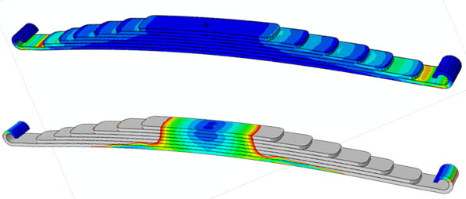
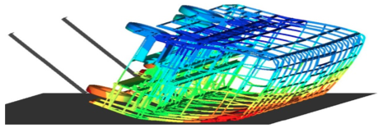
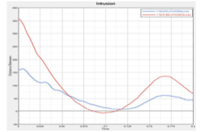
Project

Slide 18
Bus Body Building

Slide 19
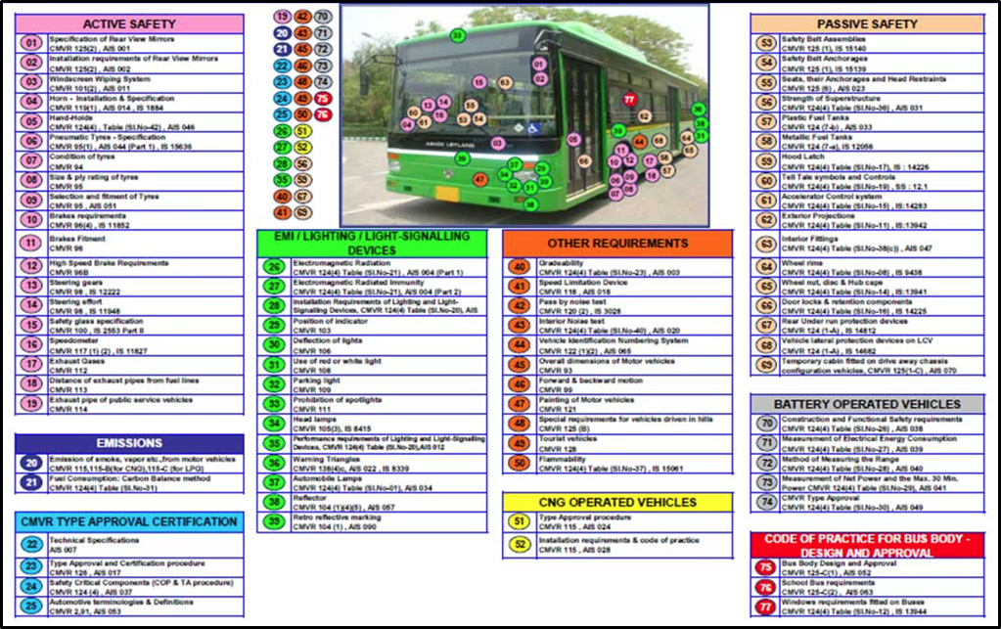
Homologation
Homologation according to AIS standards :
Provide complete homologation for Bus according to AIS
Dimensional verification according to bus code and safety technology.
Energy dissipation performance test (EDP)
Seat-back strength (SBS).
Seat strength test.(H1 & H2 test).
Seat anchorage test :- vehicle level test, which is in scope of vehicle manufacturer.

Slide 20
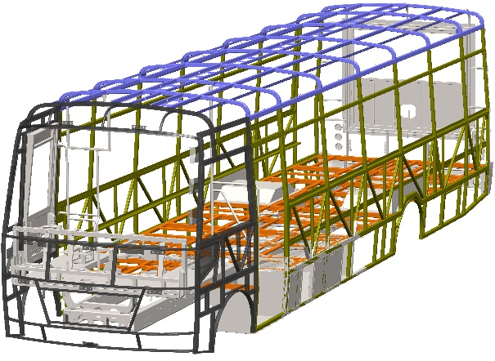
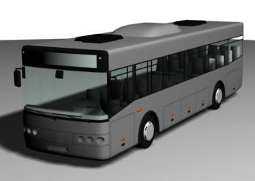
CAD
CAD Designing & Drafting :
Design of bus superstructure with assembly, part list and BOM.
Coach exterior & interior designing and surfacing.
3d model to 2d drawing and 2d drawing to 3d model for manufacturing.
Scanned image to cad conversion (jpeg, jpg, pdf).
Paper to cad conversion.
Bus body design for assured safety as per automotive Indian standard (AIS).
Assured passenger comfort in terms of dimensional and seating requirements as per automotive Indian standard (AIS).
Internationally competitive design for specific applications.
Flexible design as per customer requirements.
19

Slide 21
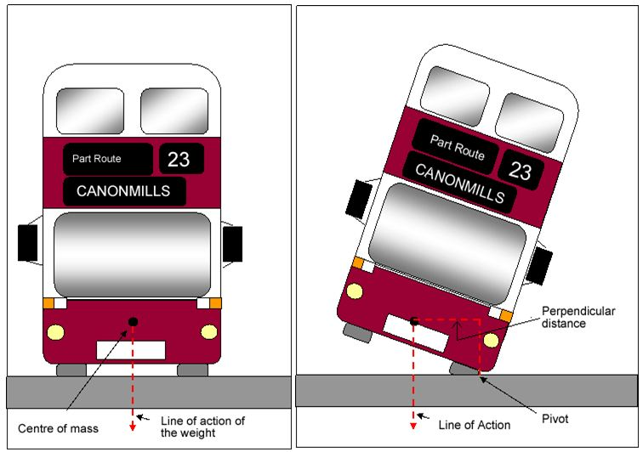
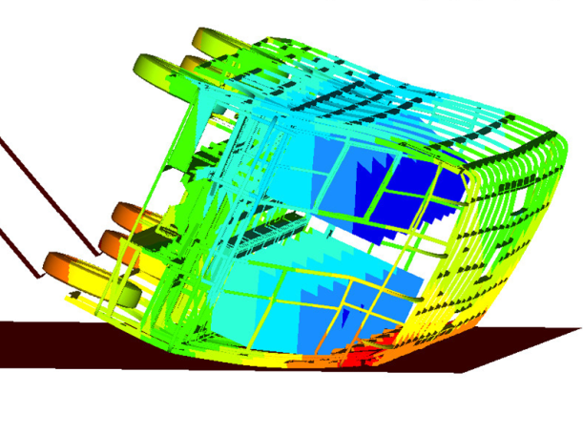
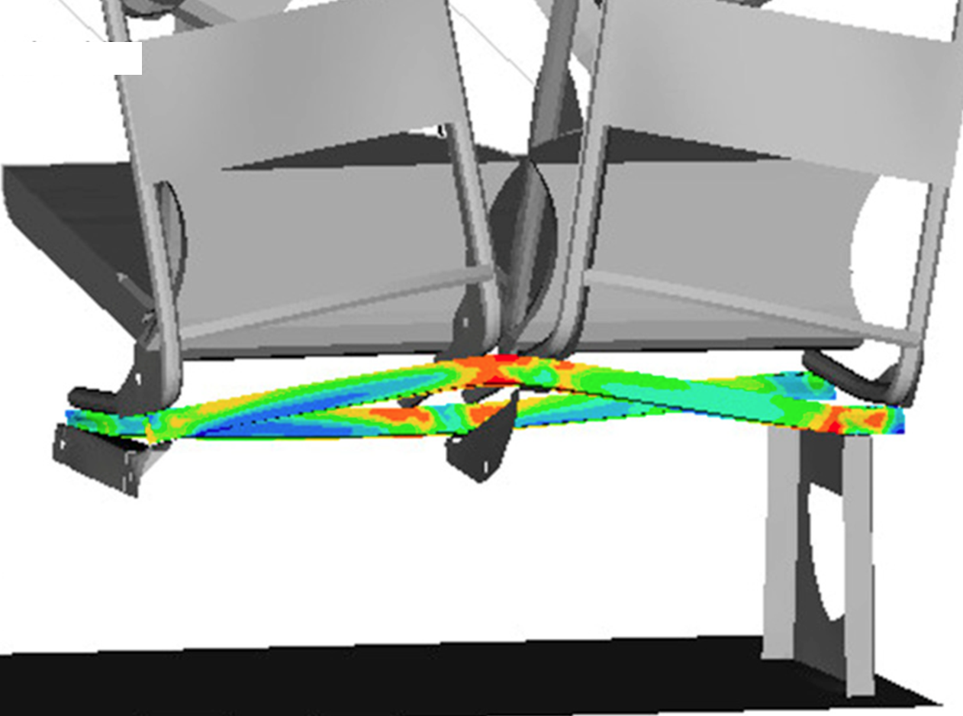
FEA
Bus structure evaluation for Stability, rollover, strength and durability as per AIS-031:
FE model of entire bus was built along with assigned non-linear material data which was generated by experimental testing
Stability test: Clause 6.2 of AIS:052
The vehicle shall not overturn, when the surface on which the vehicle stands is fitted to both sides in turn at an angle of 28 degrees from the horizontal.
Loading of the vehicle should be uniform + Standees weight + roof luggage as applicable.
Rollover analysis: As per AIS:031
Material and joint modelling technique used for rollover analysis was validated by component level testing
Rollover analysis and testing was carried out as per ECE- R 66 to check the strength of the superstructure
Rollover test on body sections verification by simulation
Other Structural Strength Analysis:
Structural strength determination of bus under braking and cornering load
Fatigue life of bus was predicted for a given road input data by using MBD, FEA and fatigue life prediction code
Stability test
Rollover analysis
Fatigue life analysis
20

Slide 22
Vertical Presence
Presence in Five Industries
Automotive :
We are bringing this unmatched technology to all the companies in the automotive industry, no matter if they are original equipment manufacturers (OEM), tier one, tier two or tier three companies
Aerospace :
Our expertise & experience in lightweight design, aerodynamics, thermodynamics and design of components and materials.
Oil & Gas :
Our expertise & experience for simulating all types of Oil & Gas equipment with mounting, clamping, adjusting, rotating etc.
Heavy Engineering :
Our expertise for simulating construction equipment, farm equipment, mining tractor & trucks, material handlers and earth movers, conveyors and crane.
Solar :

Slide 23
Project Delivery
ERFOLG have a team of talented and experienced engineers who are dedicated to making CAD, Styling & FEA technology accessible to everyone. Over the years we have been gaining experience in the fields of CAD, Styling & FEA expanding our knowledge. We have been studying industries and preparing ourselves to provide services in various fields including Automobile, Aerospace, Oil & Gas, Heavy Engineering and Solar etc. We are expanding & lending our services to various industries around the world. Our team is working onsite, offshore and onsite+offshore for our customers around the globe.
Delivery
Complete Onsite
Complete Offshore
Onsite + Offshore

Slide 24
Contact
ERFOLG Engineering Services LLP
A – 101, Amrut CHS, Dahanukar wadi,
Near Shubhashanti Complex, Kandivali (w),
Mumbai – 400067, India.
Tel +91-9167901527
+91-8291709911
+91-8291709922
+91-8291709933
E-mail info@erfolges.com
Web www.erfolges.com

Slide 25
THANK YOU FOR YOUR INTREST IN
ERFOLG

